Slide 16
SES MCSA Design Studio

Slide 19
SES MCSA Design Studio

Slide 22
SES MCSA Design Studio

Slide 25
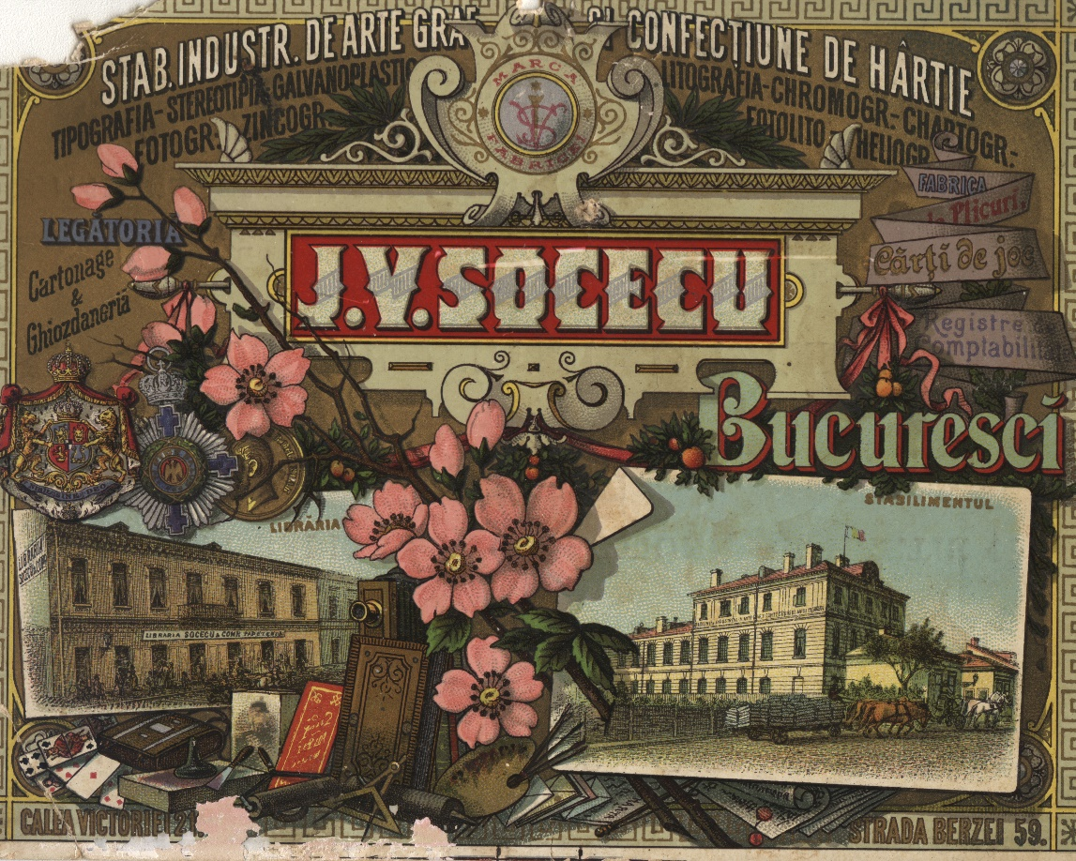

Slide 26
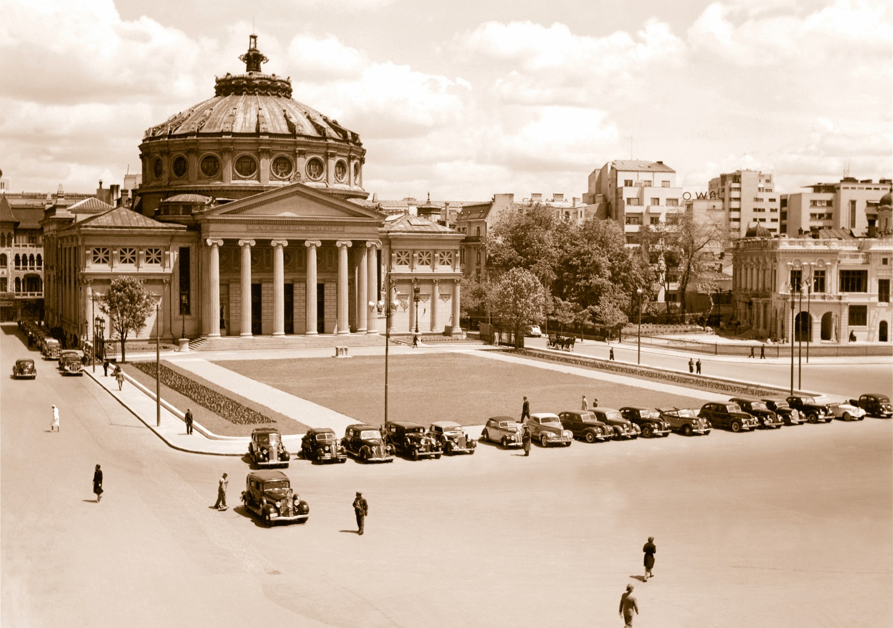
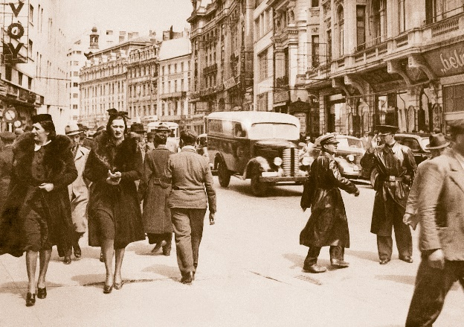

Slide 27
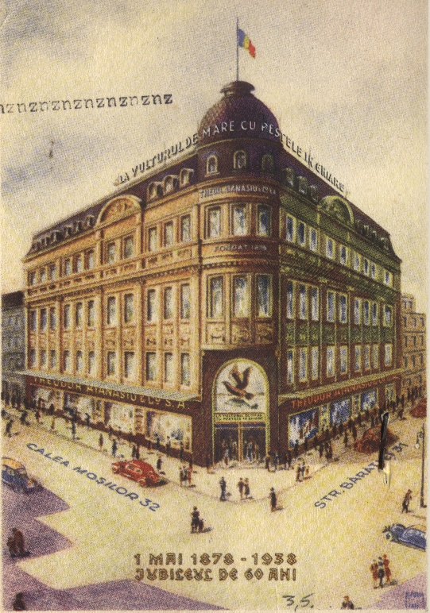
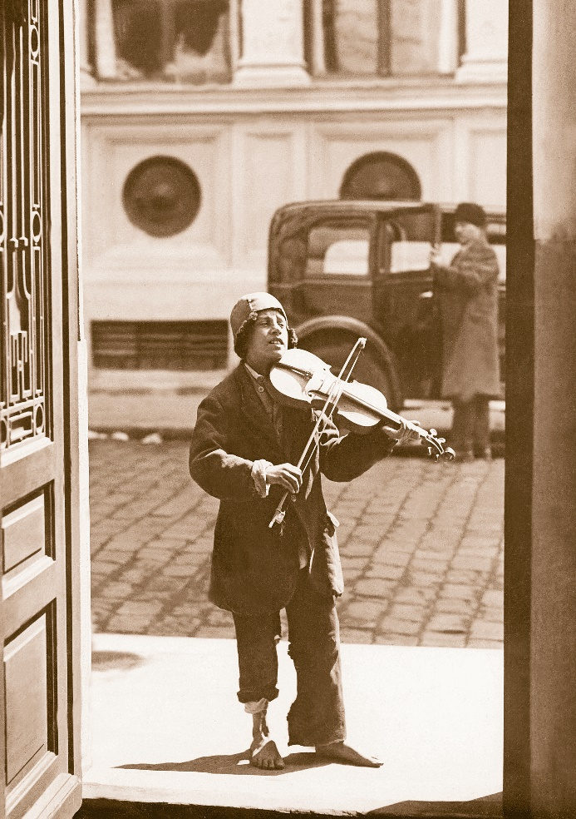

Slide 28
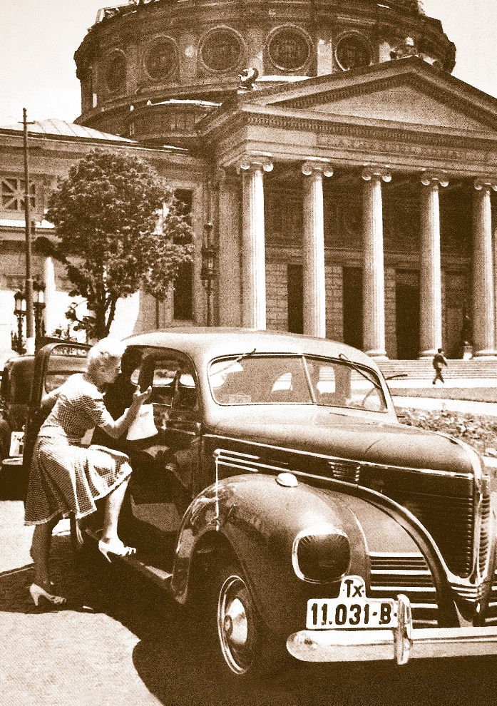

Slide 29
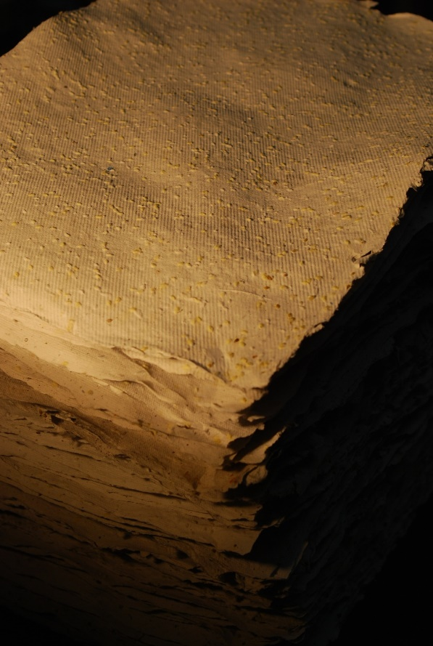

Slide 36
Persoana de contact: Alexandru Mihai MORAR- manager SES MCSA Design Studio SRL
Website: www.thesouvenir.ro
Adresa postala: Bucuresti, sectorul 1, str. Comana, nr. 50, parter
Contact:
mcsa.design.studio@gmail.com
alexandru.mihai.morar@gmail.com

